Slide 1
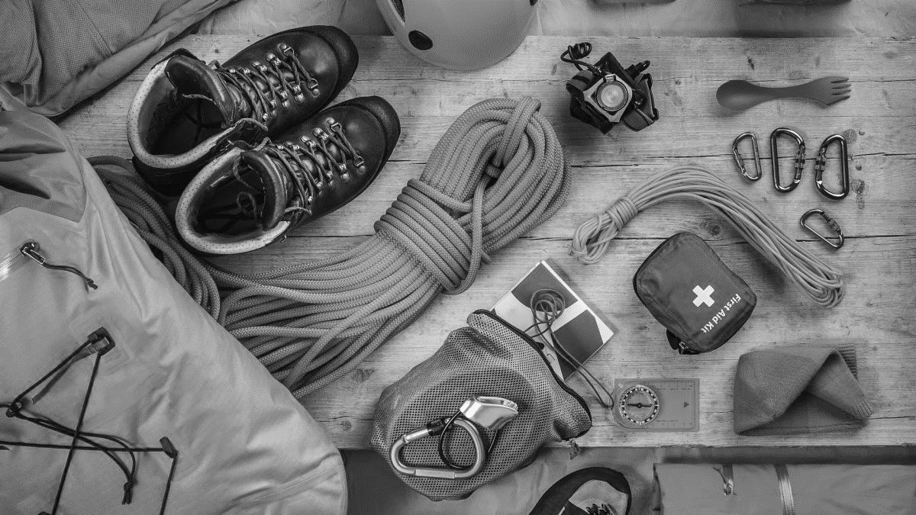

Troop 9226
Junior
Leadership
Training

Slide 2

“Training boy leaders to run their troop is the Scoutmaster’s most important job.”
“Train Scouts to do a job, then let them do it.”
“Never do anything a boy can do.”
~ Robert Baden-Powell
Troop 9226
Afton, MN

Slide 3
Mission Statement
The mission of the Boy Scouts of America is to prepare young people to make ethical and moral choices over their lifetimes by instilling in them the values of the Scout Oath and Law.
Troop 9226
Afton, MN

Slide 4
Life Skills in a Values-Based Environment
Scouting is a values-based program with its own code of conduct. The Scout Oath and Law help instill the values of good conduct and honesty. A youth who spends one year in a Scout troop will learn lifetime skills. They will learn basic outdoor skills, self-reliance, and how to get along with others.
Scouting will prepare them to live a more productive and fulfilling life.
Troop 9226
Afton, MN

Slide 5
Module 1 | Know
The Scout-Led Troop & Living the Scout Oath and Law
Discussion of a Scout-Led Patrol
Review of the Troop Organization Chart
Position Overview
National Honor Patrol Award Requirements
Troop 9226
Afton, MN

Slide 6
Scouting offers young people a rich and varied arena in which to learn and use leadership skills. Among the challenges encountered by a troop’s youth leaders are:
Organizing Patrols
Using Duty Rosters
Planning Menus and Calculating Food Costs
Encouraging Advancement
Guiding Patrols Through Problem Solving
Teaching Outdoor Skills
Helping to Ensure Patrol Safety During Outings
Handling Patrol Finances
Helping Other Scouts Make the Most of Their Own Leadership Opportunities
Troop 9226
Afton, MN

Slide 7
Junior Leadership Training (JLT) is a Scoutmaster-directed training divided into three modules:
Module 1 | Introduction to Leadership (Know)
Conducted within 30 days of a Scout’s acceptance of their new position, this session focuses on what a leader must know.
Module 2 | How to Fulfill Your Role (Be)
This session on how to fulfill the role’s responsibilities focuses on what a leader must be.
Module 3 | What is Expected of Me? (Do)
This session focuses on what a leader must do.
Troop 9226
Afton, MN

Slide 8
What does it mean when we say “a Scout-Led troop”?
The BSA’s definition is that “empowering youth to be leaders” is the core of Scouting.
A Scout Troop is a small democracy. With the Scoutmaster’s direction, youth are formed into patrols, plan the troop’s program, and make it a reality.
Troop 9226
Afton, MN

Slide 9
Troops find success by utilizing the following:
Troop Calendar
Troop Meetings
Troop Activities
Patrol Leaders’ Council
Public Service
Outdoor Activities
Troop 9226
Afton, MN

Slide 10
“The patrol method is not a way to operate a Boy Scout Troop, it is the only way. Unless the patrol method is in operation, you don’t really have a Boy Scout Troop.”
~ Robert Baden-Powell
Troop 9226
Afton, MN

Slide 11
There are three types of patrols:
Regular Patrols
New-Scout Patrols
Venture Patrols
“The object of the patrol method is not so much saving the Scoutmaster trouble as to give responsibility to the boy.”
~ Robert Baden-Powell
Troop 9226
Afton, MN

Slide 12
Patrols are successful through the following:
Patrol Meetings
Patrol Activities
Patrol Names
Troop 9226
Afton, MN

Slide 13
Troop Organization Chart
(Large Troop)
Scoutmaster
Assistant Scoutmaster
New Scout
Jr. Assistant Scoutmaster
Assistant Scoutmaster Venture
Assistant Sr. Patrol Leader
Sr. Patrol Leader
Patrol Leader’s
Council (PLC)
*Scribe is part of PLC
Den Chief
Troop Guide
New-Scout Patrol Leader
Patrol Leader
Patrol Leader
Venture Patrol
Assistant Patrol Leader
Assistant Patrol Leader
Patrol: Scribe, Quartermaster, Grubmaster, Cheermaster
Patrol: Scribe, Quartermaster, Grubmaster, Cheermaster
OA Troop Representative
Instructor
Quartermaster
Scribe
Librarian
Historian
Chaplain’s Aide
Webmaster
Troop 9226
Afton, MN

Slide 14
Troop Organization Chart
(Large Troop)
Scoutmaster
Assistant Scoutmaster
New Scout
Assistant Scoutmaster Venture
Sr. Patrol Leader
Patrol Leader’s
Council (PLC)
*Scribe is part of PLC
Den Chief
Troop Guide
New-Scout Patrol Leader
Assistant Sr. Patrol Leader
Patrol Leader
Venture Patrol
Quartermaster
Assistant Patrol Leader
Troop 9226
Afton, MN

Slide 15
SENIOR PATROL LEADER (SPL)
The SPL is elected by the Scouts to represent them as the top youth leader in the troop.
Reports to: The Scoutmaster
Runs all troop meetings, events, activities, and the annual program planning conference.
Runs the patrol leaders' council meeting.
Appoints other troop youth leaders with the advice and counsel of the Scoutmaster.
As called upon, follows procedures for properly recording the advancement of other scouts.
Assigns duties and responsibilities to youth leaders.
Assists the Scoutmaster with youth leadership training. •Sets a good example.
Enthusiastically wears the Scout uniform correctly.
Lives by the Scout Oath and Law.
Shows Scout spirit.
Troop 9226
Afton, MN

Slide 16
Assistant SENIOR PATROL LEADER (ASPL)
The Assistant Senior Patrol Leader (ASPL) is the second highest-ranking youth leader in the troop. They are appointed by the SPL with the approval of the Scoutmaster. The ASPL acts as the SPL in the absence of the SPL or when called upon. They also provide leadership to other youth leaders in the troop.
Reports to: SPL
Helps the SPL lead meetings and activities
Runs the troop in the absence of the SPL
Helps train and supervise the: Troop Scribe, Quartermaster, Instructor, Librarian, Historian, and Chaplain’s Aide
As called upon, follows procedures for properly recording the advancement of other scouts.
Serves as a member of the PLC
Sets a good example
Enthusiastically and correctly wears the Scout Uniform
Lives the Scout Oath and Law
Shows Scout Spirit
Lends a hand controlling patrols and building patrol spirit.
Troop 9226
Afton, MN

Slide 17
Patrol Leader (PL)
The patrol leader is the elected leader of their patrol. They represent their patrol on the patrol leaders’ council.
Reports to: SPL
Appoints the Assistant Patrol Leader
Represents the patrol on the PLC
Plans and steers patrol meetings
Helps scouts advance
Acts as the chief recruiter of new Scouts
Keeps patrol members informed
As called upon, follows procedures for properly recording the advancement of other scouts.
Knows what their patrol members and other leaders can do
Sets the example
Wears the uniform correctly
Lives the Scout Oath and Law
Shows Scout Spirit
Troop 9226
Afton, MN

Slide 18
Assistant Patrol Leader (APL)
The assistant patrol leader is appointed by the patrol leader and leads the patrol in their absence.
Reports to: PL
Helps their PL plan and steer patrol meetings and activities
Helps keep patrol members informed
Helps the patrol get ready for all troop activities
Represents their patrol at PLC meetings when their PL cannot attend.
Troop 9226
Afton, MN

Slide 19
Troop Guide
The troop guide works with new Scouts. They help them feel comfortable and earn their First Class rank in their first year.
Reports to: The assistant Scoutmaster for the new-Scout patrol in the troop
Introduces new Scouts to troop operations
Guards new Scouts from harassment by older Scouts
Helps new Scouts earn First Class rank in their first year
Teaches basic Scout Skills
Coaches the PL of the new-Scout patrol on their duties.
As called upon, follows procedures for properly recording the advancement of other scouts.
Works with the PL at the PLC
Attends PLCs with the PL of the new-Scout patrol
Assists the ASM with trainings
Counsels Scouts on Scouting Challenges
Sets a good example
Enthusiastically and correctly wears the Scout Uniform
Lives by the Scout Oath and Law
Shows Scout Spirit
Troop 9226
Afton, MN

Slide 20
Troop Quartermaster
The quartermaster keeps track of troop equipment and sees that it is in good working order.
Reports to: ASPL
Keeps records on patrol and troop equipment
Makes sure equipment is in good working condition
Issues equipment and makes sure it is returned in good condition
Makes suggestions for new or replacement items
Works with the troop committee member responsible for equipment
Sets a good example
Enthusiastically and correctly wears the Scout uniform
Lives by the Scout Oath and Law
Shows Scout Spirit
Troop 9226
Afton, MN

Slide 21
Troop Scribe
The scribe keeps the troop records. They record the activities of the patrol leaders’ council and keeps a record of dues, advancement, and Scout attendance at troop meetings.
Reports to: ASPL
Attends and keeps a log of PLC meetings
Records individual Scout Attendance and dues payments
Records individual Scout Advancement progress
Works with the troop committee member responsible for records and finance
Sets a good example
Enthusiastically and correctly wears the Scout uniform
Lives by the Scout Oath and Law
Shows Scout Spirit
Troop 9226
Afton, MN

Slide 22
Troop Historian
The troop historian preserves troop photographs, news stories, trophies, flags, scrapbooks, awards, and other memorabilia.
Reports to: ASPL
Gathers pictures and facts about troop activities and keeps them in a historical file or scrapbook.
Takes care of troop trophies, ribbons, and souvenirs of troop activities.
Works with Troop Webmaster to post media to the troop website
Sets a good example
Enthusiastically and correctly wears the Scout uniform
Lives by the Scout Oath and Law
Shows Scout Spirit
Troop 9226
Afton, MN

Slide 23
Troop Librarian
The librarian oversees the care and use of troop books, pamphlets, magazines, audiovisuals, and merit badge counselor lists.
Reports to: ASPL
Sets up & takes care of the troop library
Keeps records of books & pamphlets owned by the troop
Adds new or replacement items as needed
Keeps books & pamphlets available for borrowing
Keeps a system for checking books & pamphlets in/out and follows up on late returns.
Sets a good example
Enthusiastically and correctly wears the Scout uniform
Lives by the Scout Oath and Law
Shows Scout Spirit
Troop 9226
Afton, MN

Slide 24
Troop Instructor
The instructor teaches Scouting skills.
Reports to: ASPL
Teaches basic Scouting skills in troop and patrols
As called upon, follows procedures for properly recording the advancement of other scouts only in areas they’re an Instructor for.
Sets a good example
Enthusiastically and correctly wears the Scout uniform
Lives by the Scout Oath and Law
Shows Scout Spirit
Troop 9226
Afton, MN

Slide 25
Chaplain’s Aide
The chaplain’s aide works with the troop chaplain to meet the religious needs of Scouts in the troop. They also work to promote the religious emblems program.
Reports to: ASPL
Assists the troop chaplain with religious services at troop activities
Tells Scouts about the Religious Emblem program for their faith
Makes sure religious holidays are considered during the troop program planning process
Helps plan for religious observance in troop activities
Sets a good example
Enthusiastically and correctly wears the Scout uniform
Lives by the Scout Oath and Law
Shows Scout Spirit
Troop 9226
Afton, MN

Slide 26
Den Chief
The den chief works with the Cub Scouts, Webelos Scouts, and den leaders in the Cub Scout pack.
Reports to: The den leader in the pack and the assistant Scoutmaster for the new-Scout patrol in the troop
Knows the purposes of Cub Scouting
Helps Cub Scouts advance through Cub Scout ranks
Encourages Cub Scouts to join a BSA Troop upon graduation
Assists with the activities during den meetings
Is a friend to the Cub Scouts in the den
Helps out at weekly den meetings and monthly pack meetings
Meets with adult members of the pack, den, and troop as needed
Sets a good example
Enthusiastically and correctly wears the Scout uniform
Lives by the Scout Oath and Law
Shows Scout Spirit
Troop 9226
Afton, MN

Slide 27
Junior Assistant Scoutmaster
The Junior Assistant Scoutmaster serves in the capacity of an assistant Scoutmaster except where legal age and maturity are required. They must be at least 16 years old and not yet 18. They are appointed by the Scoutmaster because of their leadership ability.
Reports to: The Scoutmaster
Functions as an Assistant Scoutmaster
Performs duties as assigned by the Scoutmaster
As called upon, follows procedures for properly recording the advancement of other scouts.
Sets a good example
Enthusiastically and correctly wears the Scout uniform
Lives by the Scout Oath and Law
Shows Scout Spirit
Troop 9226
Afton, MN

Slide 28
National Honor Patrol Award
The National Honor Patrol Award is given to patrols whose members make an extra effort to have the best patrol possible. A patrol can earn the award by doing the following over a three-month period:
Have a patrol name, flag, and yell. Put the patrol design on equipment, and use the patrol yell. Keep patrol records up-to-date.
Hold two patrol meetings every month.
Take part in at least one hike, outdoor activity, or other Scouting event.
Complete two Good Turns or service projects approved by the patrol leaders’ council.
Help two patrol members advance one rank.
Wear the full uniform correctly at troop activities (at least 75 percent of patrol’s membership).
Have a representative attend at least three patrol leaders’ council meetings.
Have eight members in the patrol or experience an increase in patrol membership.
Troop 9226
Afton, MN

Slide 29
Vision Statement
The Boy Scouts of America will prepare every eligible youth in America to become a responsible, participating citizen and leader who is guided by the Scout Oath and Law.
In the future, Scouting will continue to:
Offer young people responsible fun and adventure;
Instill in young people lifetime values and develop in them ethical character as expressed in the Scout Oath and Law;
Train young people in citizenship, service, and leadership;
Serve America’s communities and families with its quality, values-based program.
Troop 9226
Afton, MN

Slide 30
Module 2 | Be
Scoutmaster’s Vision of Success
Teaching EDGE™ Discussion
Troop Progress Discussion
Troop 9226
Afton, MN

Slide 31
What is EDGE™?
EDGE™ is the method you will use to teach in your troop. The key to making EDGE™ work, is to use it for all teaching opportunities. Make it a habit.
Explain: The trainer explains how something is done
Demonstrate: After the trainer explains, they demonstrate while explaining again.
Guide: The learner tries the skill while the trainer guides them through it.
Enable: The trainee works on their own under the watchful eye of the trainer. The trainer’s role in this step is to remove any obstacles to success, which enables the learner to succeed.
Troop 9226
Afton, MN

Slide 32
How is the troop doing?
Based on what you’ve learned so far, please answer the following questions:
What should we start doing that we are not currently doing?
What should we stop doing that is not working?
What should we continue doing that is working well and helps us succeed?
Troop 9226
Afton, MN

Slide 33
Module 3 | Do
Servant Leadership – Motivating to Lead
Define Success in Your Position
Troop 9226
Afton, MN

Slide 34
What is Servant Leadership?
Servant leadership is a leadership philosophy built on the belief that the most effective leaders strive to serve others, rather than accrue power or take control.
Servant leaders always listen to people before they speak their minds. They want to know what their people think and how they feel.
Troop 9226
Afton, MN

Slide 35
The Four Principles of Servant Leadership
Encourage Diversity of Thought
Create a Culture of Trust
Have an Unselfish Mindset
Foster Leadership in Others
Troop 9226
Afton, MN

Slide 36
Define Success in Your Position
What does it mean to be successful in your position?
Please finish the following sentence with your own words:
“I’ll know I was successful as a insert the name of your role here if I’m able to __________________.”
Troop 9226
Afton, MN

Slide 37
Homework!
Get to know the scouts you’re responsible for helping. Learn what they need and how you can better serve them in your new role!
Troop 9226
Afton, MN

Slide 38
Thank you for attending JLT!
Troop 9226
Afton, MN

